Slide 1
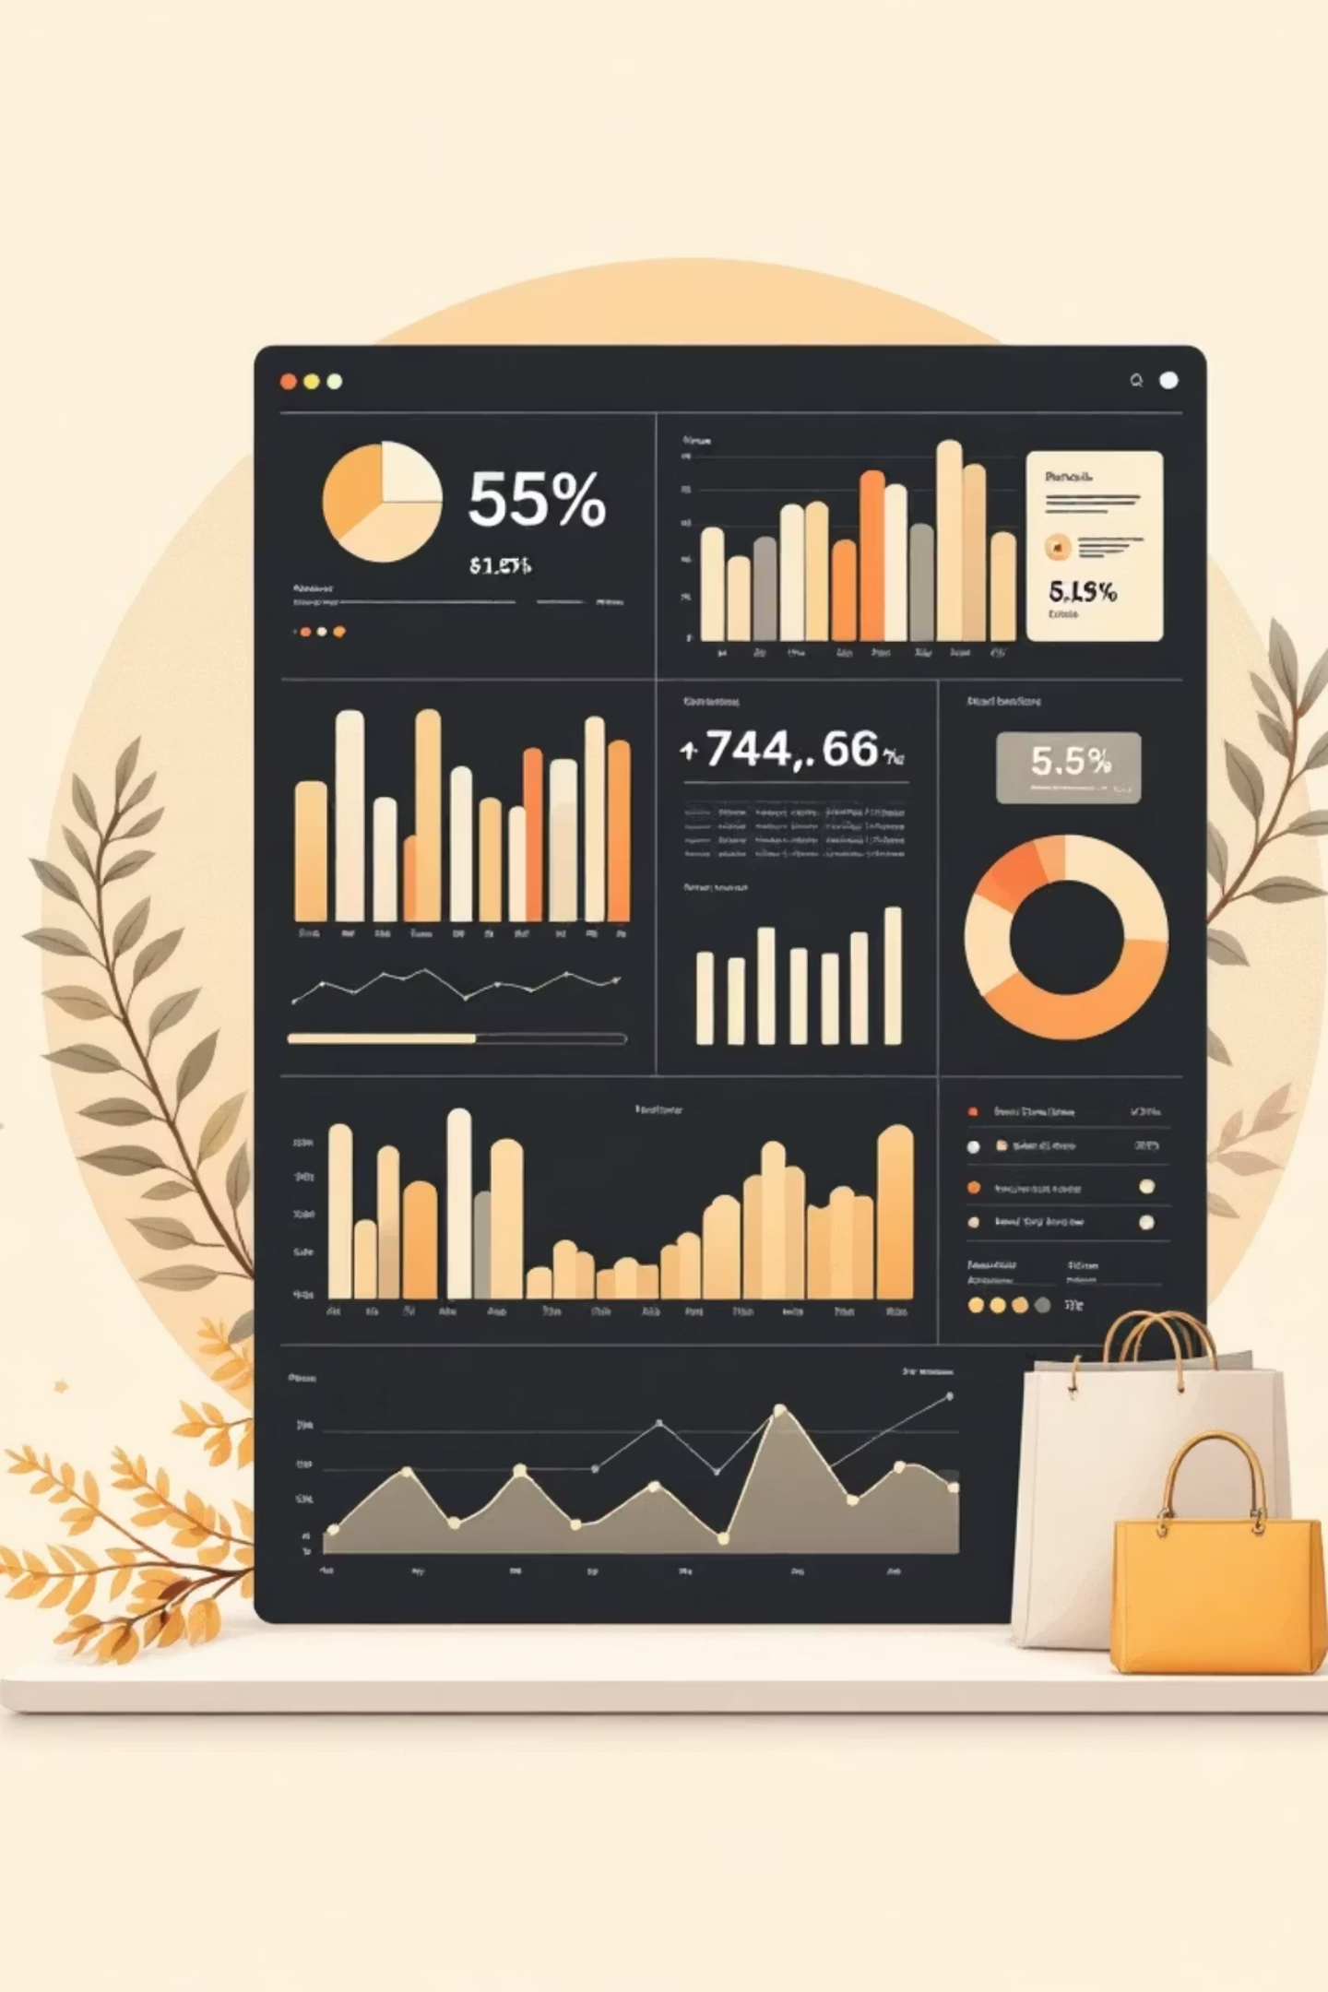
Customer Shopping Behavior Analysis
Uncovering actionable insights from 3,900 customer transactions to drive strategic business growth and optimize revenue opportunities

Slide 2

Dataset Overview
3,900
18
37
Total Purchases
Data Columns
Missing Values
Comprehensive transaction records
Customer demographics & behavioral patterns
Only in Review Rating column

Slide 3
Data Preparation Process
01
02
03
Data Loading
Initial Exploration
Missing Data Handling
Imported comprehensive dataset using pandas library
Conducted structure checks and generated summary statistics
Imputed Review Rating values using median methodology
04
05
Feature Engineering
Database Integration
Created age groups and purchase frequency segments
Connected to PostgreSQL for advanced querying

Slide 4
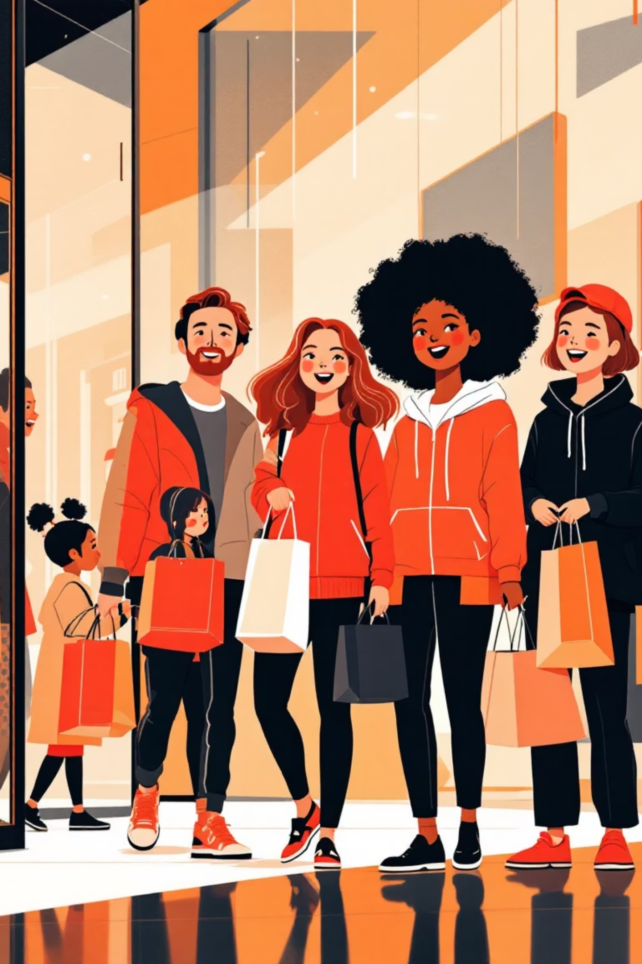
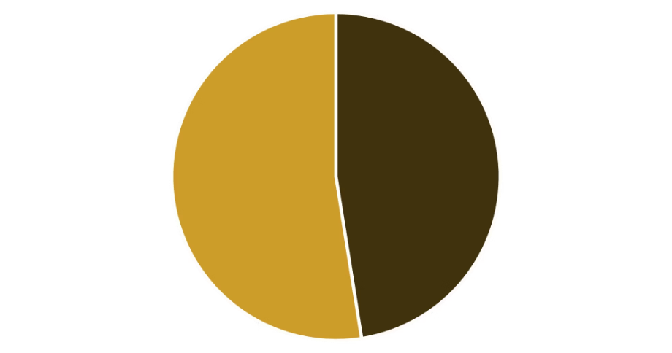
Revenue by Gender Analysis
Key Insight
Female customers generate slightly higher total revenue compared to male customers
Gender-based marketing strategies could optimize revenue streams and improve targeting effectiveness

Slide 5

High-Value Discount Users
Smart Shoppers Identified
Premium Value Seekers
Customers using discounts while maintaining above-average purchase amounts
High spenders who strategically maximize value through discount optimization
Strategic Opportunity
Target these customers with exclusive VIP offers and loyalty rewards

Slide 6
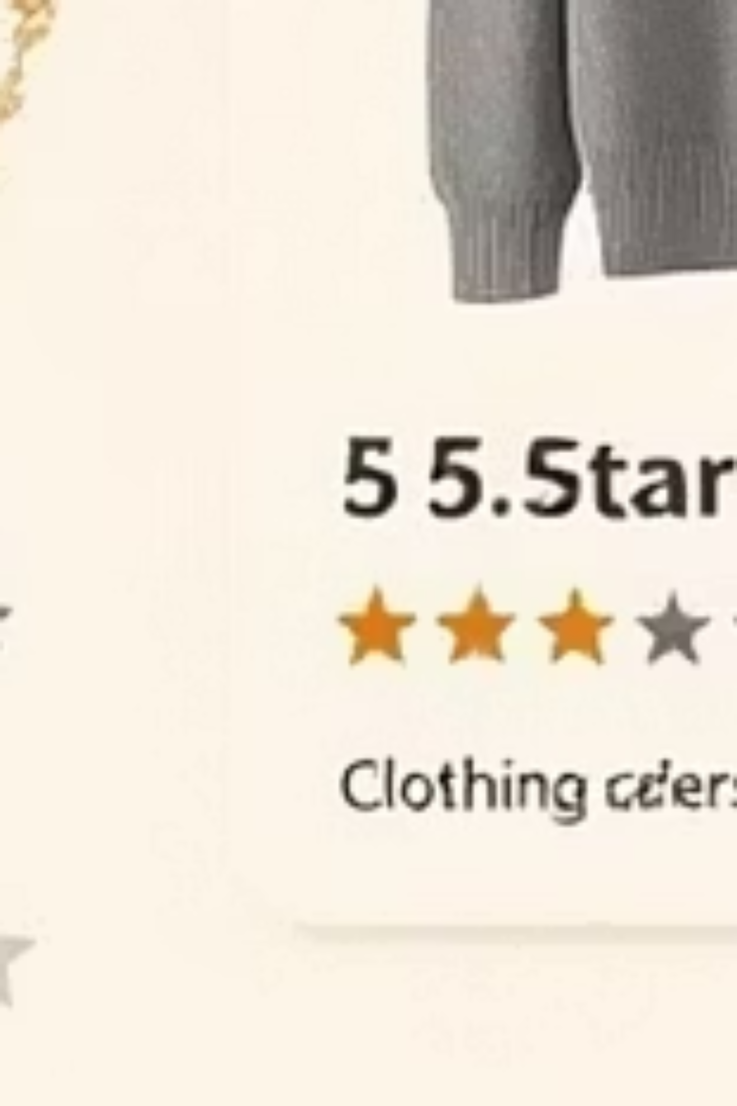


Top-Rated Products
5
5
Blouse
Dress
Highest customer satisfaction scores across all product categories
Consistently excellent reviews demonstrate quality and fit
4
Shirt
Strong customer approval with reliable performance

Slide 7


Shipping Preferences Impact
Express Shipping
$65
Average purchase amount per transaction
Standard Shipping
$58
Average purchase amount per transaction
Express shipping customers spend 12% more per transaction — indicating higher-value customer segment with urgency-driven purchasing behavior

Slide 8
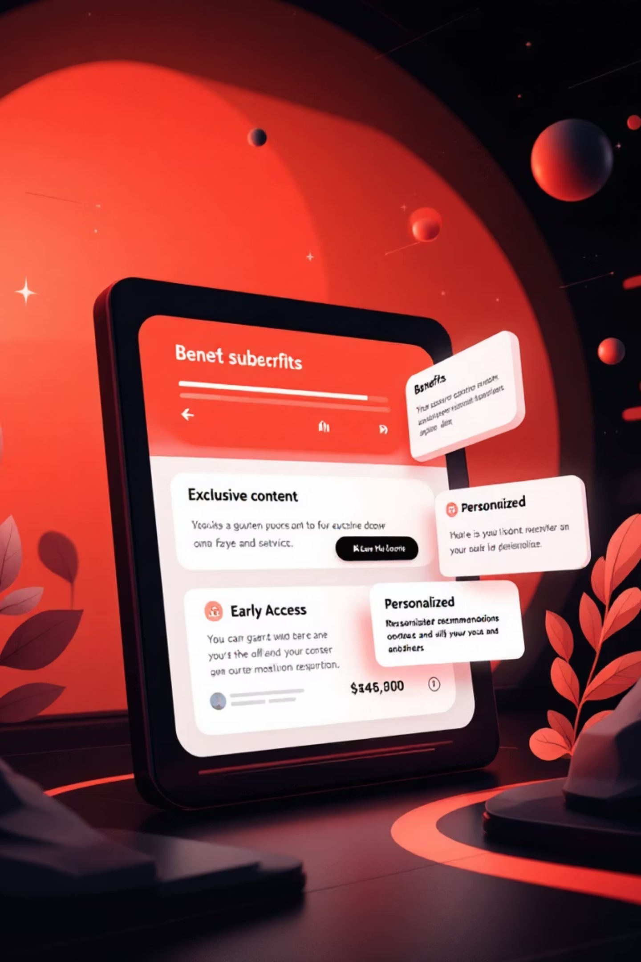



Subscription Impact on Revenue
35%
42%
Higher Spend
Revenue Share
Subscribers outspend non-subscribers significantly
Total revenue contributed by subscription customers
68%
Loyalty Rate
Repeat purchase frequency among active subscribers
Subscription model drives both customer lifetime value and purchase frequency, creating predictable revenue streams

Slide 9



Customer Segmentation Strategy
Loyal
1
15% — Premium high-value customers
Returning
2
35% — Regular repeat shoppers
New
3
50% — First-time buyer acquisition
Growth Strategy: Focus resources on converting New customers to Returning status, then nurture Returning customers into Loyal brand advocates

Slide 10





Strategic Recommendations
Boost Subscriptions
Promote exclusive benefits and cost savings for subscriber members
Loyalty Programs
Reward repeat buyers with tiered benefits to increase retention rates
Targeted Marketing
Focus campaigns on high-revenue segments and express shipping users
Product Positioning
Highlight top-rated products prominently in all marketing campaigns

